Slide 1
An Investigative Study into the Properties of the GoogLeNet Image Recognition Network
Adam Horvath-Smith
Wright State University
April 18, 2019

Slide 2
Overview
Brief introduction to the GoogLeNet image recognition network
Project goals and motivations
“Feature of interest” selection
Adversarial image generation
Overview of methods
Experimental results

Slide 3
Introduction
Interpretability is big question in machine learning research
Want to open the “black box” to understand how decisions are made
GoogLeNet is frequent subject for interpretability research
Can mix visualization with machine learning to get better picture of neural network decision
Notes:
Begin with stuff about “open ended inquiry”…
Talk about building research off existing research (mention Olah article)
--this is why it was chosen

Slide 4
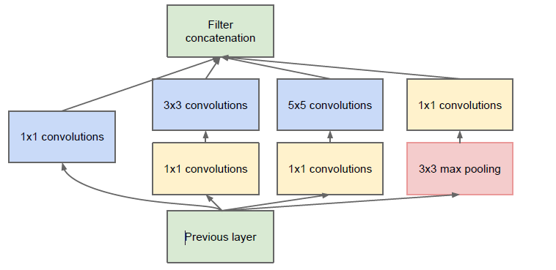
The GoogLeNet Architecture
Deep convolutional neural network (22 layers)
Based on Inception architecture (Szegedy et al.)
Each module does three parallel convolutions, plus max pooling
Nine such modules in GoogLeNet
Figure 1: Inception module architecture.
Notes:
Credit ideas here to Olah in Building Blocks

Slide 5
Saliency Maps
Add meat here if needed
Notes:
Credit ideas here to Olah in Building Blocks

Slide 6
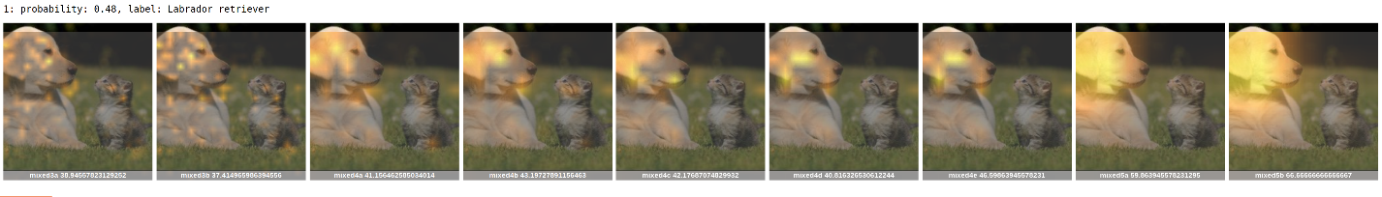
Visualizing GoogLeNet
Research inspired by “The Building Blocks of Interpretability,” Chris Olah et al.
Found various ways to visualize outputs of each of the nine Inception modules
Used algorithm and code base to generate saliency maps on the outputs of each of the nine Inception modules

Slide 7
Initial Plans
Initial thought was to see if there was correlation in saliency map highlighting and classification confidence
More highlighted areas = more confidence in output classification
Traced several images through GoogLeNet, producing series of saliency maps for each Inception module
Expected to see more highlighting for top few predictions, less highlighting for lower predictions
Early testing proved this not to be so
Notes:
Acknowledge Raymer for his part in talking me out of this
Reference the previous slide for example of maps

Slide 8
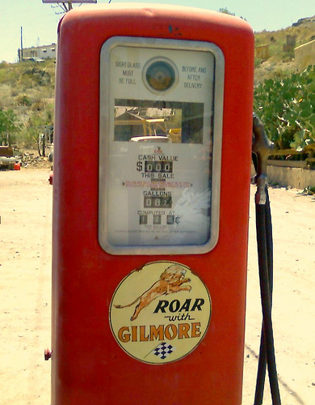
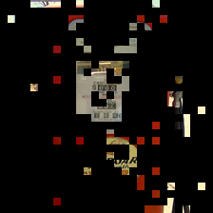
Features of Interest
Rather than focus on the saliency maps, look at what features they highlight
Wanted to find the features of interest for a particular class of images
These “features of interest” pull out the areas of an image that the network looked at to classify it
Extracted by thresholding the saliency maps above certain pixel value, then picking out parts of image corresponding to these thresholded regions
Figure 2: An example image, the saliency map generated after running through Inception module Mixed3A, and its related areas of interest. Note how the counters on the gas pump are highlighted in the final image, meaning these are an area of interest for the “gas pump” classification.
Notes:
Talk more about what these thresholds were (0.5)
Walk thorugh the example images

Slide 9
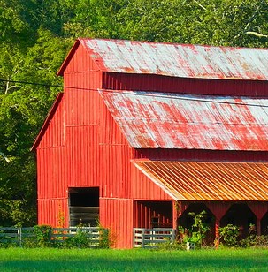
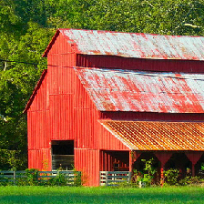

Features of Interest
Leveraged features of interest to try to better fool GoogLeNet
Generated adversarial images based on Expectation Over Transformation algorithm
Found most suitable out of a number of other algorithms (FGSM, one-pixel attack, etc.)
Adds imperceptible noise to base image to change classification prediction
Figure 3: The first image on the left is an original, unaltered photo of a barn. The middle image was created by the adversarial generation framework to be classified by GoogLeNet as an electric ray, which does not share similar features with the barn class. The third photo is an adversarial image made to be classified as a boathouse, which does share similar visual features with the barn.
Notes:
Acknowledge FOIs don’t tell us much on their own
Talk about other algorithms (FGSM) and why I didn’t use these (inability to give own class)
Also discuss turtle example for EOT robustness

Slide 10
Data Collection and Generation
Collected 100 images from ImageNet database
Five images from each of 20 ground-truth classes
Chose images that GoogLeNet had high confidence (80%+) in for ground-truth class
Classes chosen at random
Generated saliency map and extracted features of interest for each image
For each of these images, generated corresponding adversarial images to run back through GoogLeNet
Notes:
Explain why high-conf images and how I confirmed these
Transition to next slide with more info about adversarial generation

Slide 11
Data Collection and Generation
Two groups of adversarial images
1: Generated based on random adversarial class
2: Generated based on adversarial class deemed “similar” to the base class
300 random adversarial images generated
Each of the 100 base images was used to generate adversarial for one of three classes
Random adversarial classes included “electric ray,” “wild boar,” “saltshaker”
100 similar adversarial images generated
Based on classes with shared similar features to the original base image
GOAL: Determine which of the two classes better fools GoogLeNet
Notes:
Explain similar relates to FOIs
Explain why so few similar images
Link to next slide with chart
Explain how goal can relate to the similar features thing

Slide 12
Base to Adversarial Class Mapping
Base Class | Adversarial Class
Barn (425) | Boathouse (449), Church (497)
Bullet Train (466) | Bobsled (450), Passenger Car (705)
Christmas Stocking (496) | Mitten (658), Sock (806)
Colobus (375) | Gibbon (368), Guenon (370)
Dam (525) | Breakwater (460)
Gas Pump (571) | ATM (480), Payphone (707)
Mashed Potato (935) | Cauliflower (938)
Nematode (111) | Gar (395)
Polaroid (732) | Projector (745), Reflex Camera (759)
Rotary Telephone (528) | Payphone (707)
School Bus (779) | Ambulance (407)
Slide Rule (798) | Computer Keyboard (508), Ruler (769)
Water Tower (900) | Hot-Air Balloon (417), Planetarium (727)
Weevil (307) | Leaf Beetle (304), Long-Horned Beetle (303)
Notes:
Mention that not all images were used here
--Talk about ImageNet difficulties

Slide 13
Results
Notes:
Note what the axes mean, why two groups
Explain how the base probs are same across all classes in a group

Slide 14
Results
Notes:
Explain again what each of the axes and probs are
--Note how groups partitioned based on which similar image classes there are
Note how the adversarial predictions are higher (possibly compare back to last slide)
Probably note some of the weird exceptions too (boar, bus)

Slide 15

Results
Adversarial Image Type | Average Confidence in Adversarial Class
Random | 0.9384
Similar | 0.9962
Note average is about 5.8% higher for similar images versus random images
Not large difference, but notable that similar adversarials have near-100% confidence in predictions
Shows using similar features of interest can improve the quality of adversarial images used to fool neural network

Slide 16
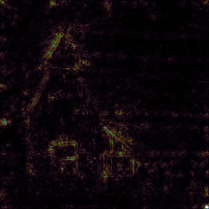
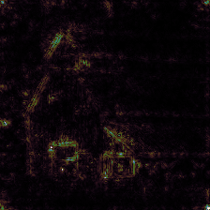
Future Work
Time constraints have left some questions open in this inquiry
Why are adversarial predictions so good?
EOT algorithm known to produce high-confidence adversarial images, but not usually this good
Other algorithms don’t usually produce confidences this high at all
Often, adversarial confidences lower than in original image predictions
Which features does GoogLeNet look at when classifying adversarial?
Could not extract features of interest from the adversarial (they matched originals)
Tried to generate saliency maps for insight, but also similar to originals
Notes:
Note EOT was chosen because of high confidence, but still wasn’t supposed to be this high
Explain more about why I couldn’t get FOIs (different Gnet)
Walk through the images at bottom (left unaltered, right is electric ray)

Slide 17
Conclusion
Gained insights into how GoogLeNet arrives at its decisions
Relies on distinct features of an image to attribute it to a given class
Can leverage features GoogLeNet looks for to better fool the network
Possible to use this knowledge to build neural network that better avoids these pitfalls
Opened up further research into why adversarials produce such high classification confidence, and what in the adversarial actually fools the network

Slide 18
Discussion

